Slide 1


DSA0402 - FUNDAMENTALS OF DATA SCIENCE
CO2 AT-2
Student Performance Analysis System
Supervisor
Dr M K Sundaram
Presented by:
Valli Karthik (192324258)

Slide 2


Problem Statement
Colleges store thousands of student records every semester.
It is difficult to manually:
Analyze marks
Track attendance
Calculate pass percentage
Identify weak students
Objective
Develop a Python-based system that analyzes student academic performance automatically.

Slide 3
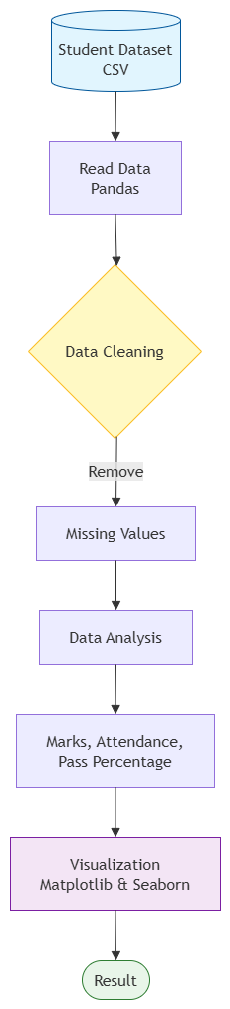
System Workflow

Slide 4
Explanation of Libraries
Python:
Purpose
Python is the main programming language used to develop the Student Performance Analysis System.
Features
Easy to learn
Simple syntax
Open source
Cross-platform
Supports Machine Learning and Data Science
Role in Project
Reads student data
Performs calculations
Applies conditions
Displays results

Slide 5
Pandas & Numpy
Pandas
Purpose:
Pandas is used for data handling and preprocessing.
Functions Used
read_csv()
head()
drop_duplicates()
isnull()
value_counts()
Role in Project
Reads CSV file
Cleans dataset
Organizes data
Filters records
NumPy
Purpose
NumPy performs numerical calculations.
Functions Used
mean()
max()
min()
where()
Role in Project
Calculates average marks
Finds highest mark
Finds lowest mark
Determines Pass/Fail status

Slide 6
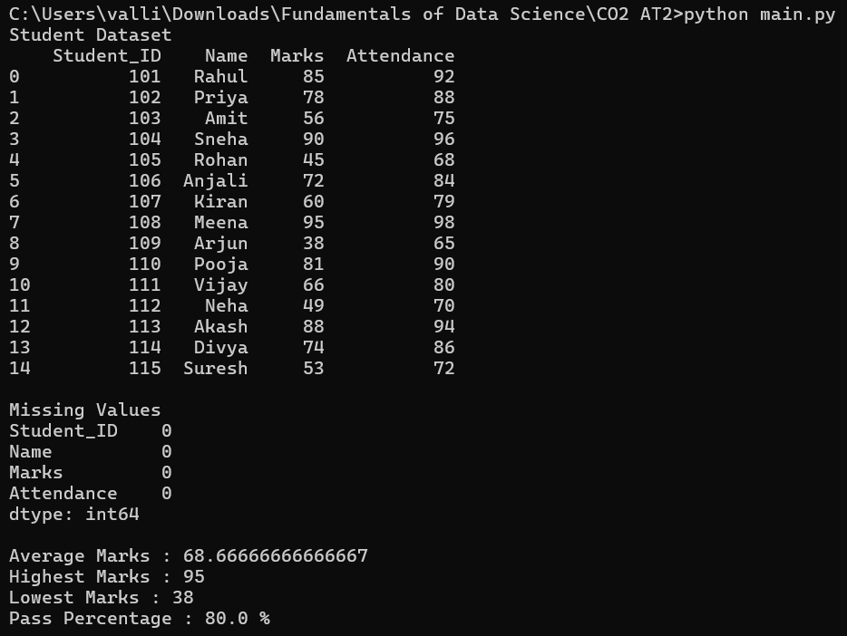
Data Preprocessing
Code:
import pandas as pd
import numpy as np
import matplotlib.pyplot as plt
import seaborn as sns
# Read Dataset
df = pd.read_csv("students.csv")
print("Student Dataset")
print(df)
# -------------------------
# Data Preprocessing
# -------------------------
print("\nMissing Values")
print(df.isnull().sum())
# Remove Duplicates
df = df.drop_duplicates()
# Add Result Column
df["Result"] = np.where(df["Marks"] >= 50, "Pass", "Fail")
# Statistics
average_marks = np.mean(df["Marks"])
highest_marks = np.max(df["Marks"])
lowest_marks = np.min(df["Marks"])
pass_percentage = (df["Result"]=="Pass").mean()*100
print("\nAverage Marks :", average_marks)
print("Highest Marks :", highest_marks)
print("Lowest Marks :", lowest_marks)
print("Pass Percentage :", pass_percentage,"%")
Before Analysis
Dataset contains
Missing values
Duplicate records
Incorrect marks
Empty attendance
Techniques used
Remove duplicates
Fill missing values
Convert data types
Normalize data
Output
Clean dataset ready for analysis.

Slide 7
Matplotlib and Seaborn
Matplotlib
Purpose
Matplotlib creates graphical visualizations.
Charts Used
Bar Chart
Pie Chart
Histogram
Role in Project
Displays student marks
Shows pass percentage
Visualizes mark distribution
Seaborn
Purpose
Seaborn creates advanced statistical visualizations.
Chart Used
Heatmap
Role in Project
Displays correlation between marks and attendance
Makes graphs more attractive and informative

Slide 8
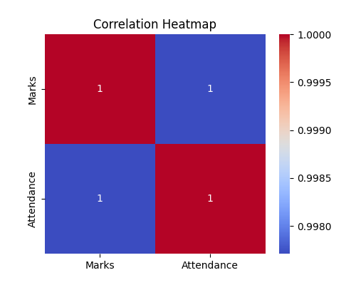
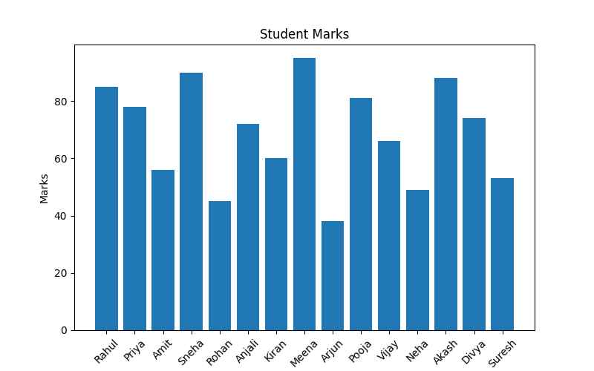
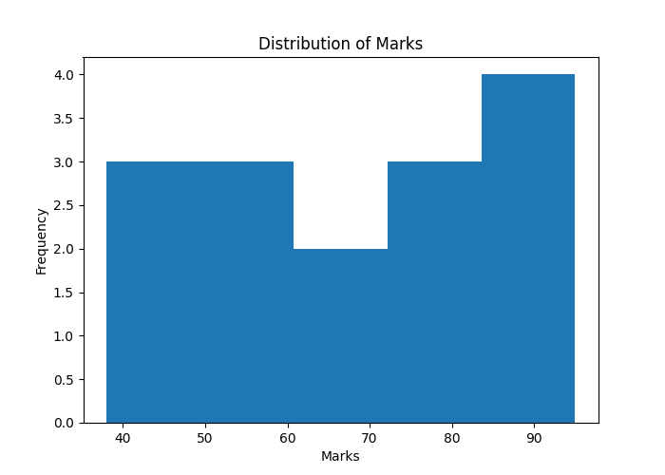
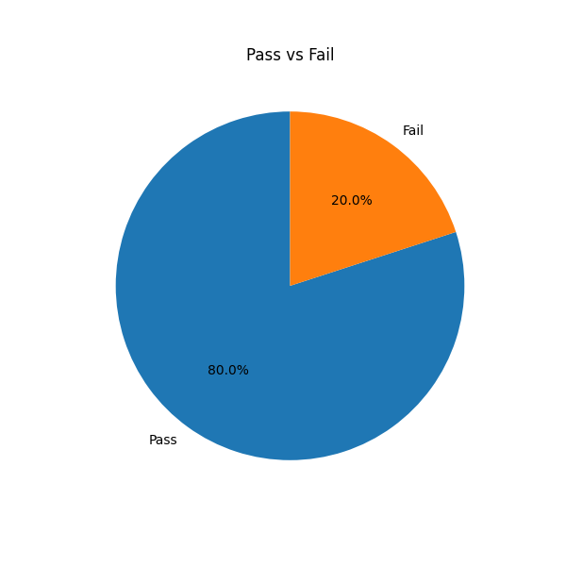
Matplotlib and Seaborn
Bar Chart
Heat Map
Histograph Chart
Pie Chart

Slide 9
Results & Advantages
Key Findings
Students with higher attendance generally scored better marks.
12 students passed and 3 students failed.
Data visualization made it easy to identify top-performing and low-performing students.
The system generated accurate statistics within seconds.
Advantages
Automates student performance analysis
Reduces manual calculation errors
Saves teachers' time
Easy to understand through graphs and charts
Helps identify students needing academic support
Supports better academic decision-making

Slide 10
Conclusion
The Student Performance Analysis System demonstrates how Python and its data science libraries can efficiently analyze student academic data.
Through this project:
Python was used to develop the application.
Pandas and NumPy simplified data preprocessing and numerical analysis.
Matplotlib and Seaborn created meaningful visualizations.
The system identified student performance, attendance trends, and pass percentage.
Data-driven insights help teachers make better academic decisions.
Future Enhancements
Predict student performance using Machine Learning.
Develop an interactive dashboard using Streamlit.
Connect the system to a real-time student database.
Send automatic performance reports to students and parents.

Slide 11


